Slide 1
Accountability Keywords
Keynote
17/09/2020
Inclusive Governance for Sustainable Landscapes
From participation to accountable governance
Jonathan Fox
Accountability Research Center, School of International Service, American University

Slide 2
What are keywords?
• Keywords capture big ideas, phenomena or explanations
Not “merely academic” – because…
Shared vocabulary enables collaboration across sectors, cultures & disciplines
The term “keywords” was in widespread use before it became a digital search term (Williams 1976)
• The meanings of “keywords” are constructed & contested
• The “keywords” approach has now been applied widely across disciplines & sectors

Slide 3
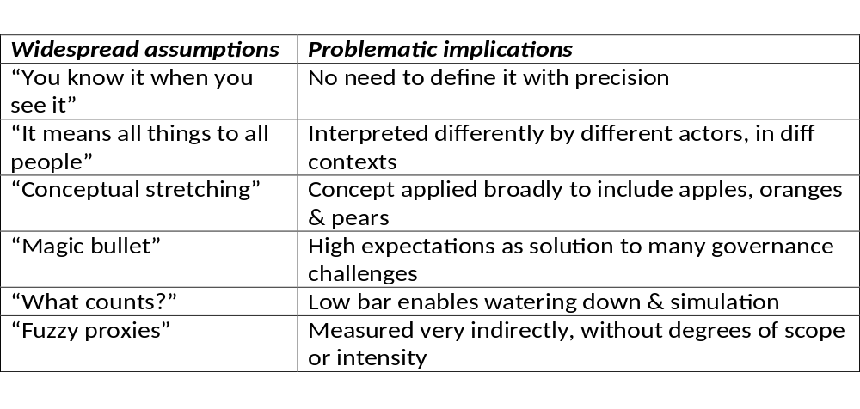
“Participation” and “accountability share conceptual challenges…

Slide 4
Related concepts overlap with accountability - but are not synonyms:
Good governance – Technocratic authoritarianism can produce versions of “good governance” without accountability - while checks and balances can lead to gridlock
Democracy – Theorists assume democracy necessarily involves accountability, but effective answerability + checks and balances may be lacking in practice
Responsive governance – Authorities can respond to voice or pressure – but at their discretion, without having to answer for their actions
Responsibility – Accountability requires clear identification of who is responsible for decisions, yet they may deny that responsibility (“passing the buck”)
Transparency – Necessary but not sufficient for (public) accountability
Justice – The punishment may not fit the crime

Slide 5
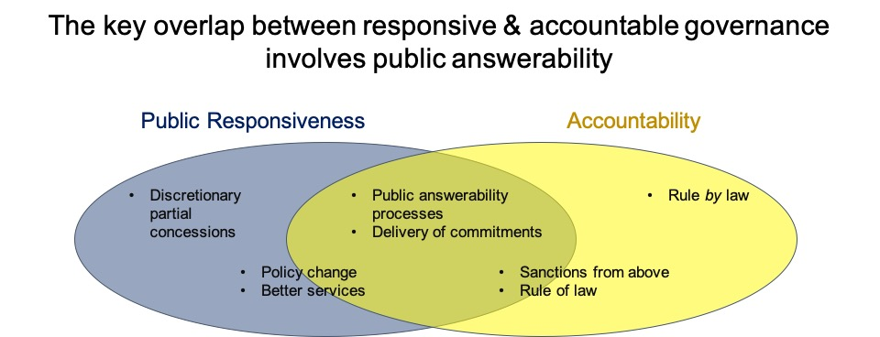
Visualizing overlapping concepts

Slide 6
“What counts” as accountability?
Accountability involves two key processes:
“Answerability” – Process or forum in which duty-bearers (decision-makers) must explain & justify their actions. This requires relevant info & involves taking responsibility.
Consequences – Involves tangible responses, either sanctions or rewards (enforcement of standards)
Note: The dominant approach to accountability is retrospective. In contrast, preventative approaches involve measures to reduce the likelihood of accountability failures.

Slide 7
Accountability with adjectives
Governance analysts use spatial metaphors:
> Vertical (upwards - as w/ principal-agent – to donors & governments - or from authorities downwards to citizens)
> Horizontal (mutual/checks & balances – as with CPR institutions)
> Diagonal (state-society power-sharing – as with multi-stakeholder forums that exercise authority)

Slide 8
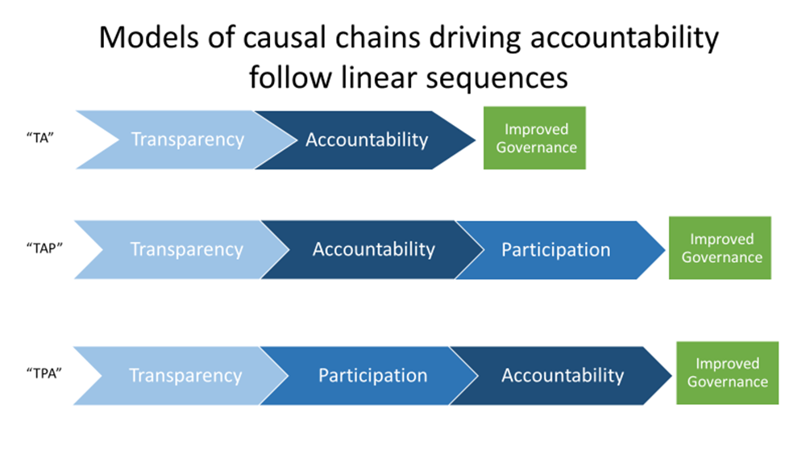
Researchers’ favorite theory of change

Slide 9
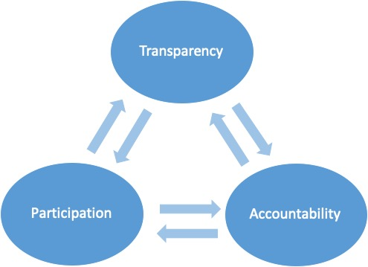
What if the drivers of accountable governance is iterative/reciprocal rather than linear?

Slide 10
What concepts can help to identify the missing links between participation & accountable governance?
Work in progress unpacks concepts relevant to connecting the dots - such as:
  Social accountability
  Strategy & tactics
  Transparency & right to know
  Checks & balances
  Countervailing power
  Advocacy
  Whistleblower

Slide 11
What is social accountability (SAcc)?
SAcc initiatives encourage stakeholder voice & action to promote responsive governance.
This evolving umbrella category includes:
  Citizen monitoring & oversight of public and/or private sector performance (e.g., scorecards)
  User-centered public information access/dissemination
  Complaint & grievance redress mechanisms
  Participation in resource allocation decision-making (e.g., social funds)
  Deliberative multi-stakeholder forums

Slide 12
Research on SAcc shows its limits
Transparency may not lead to accountability (info is often not power)
Focus on organizing autonomous constituencies often missing
Induced participation, limited to ‘invited spaces,’ is often captured or ignored
Bottom-up monitoring of governance – by itself - often lacks bite
Yet sometimes SAcc initiatives do matter
What makes the difference?

Slide 13
Unpack SAcc initiatives for accountable governance
Tactics vs. strategies - What’s the difference?
In the social accountability field, these terms are often confused
Strategies define goals and the pathway to reach them
Tactics are the specific actions for carrying out such plans (tools)
Therefore: Strategies should drive tactics (not so obvious…)

Slide 14
Tactical approaches to SAcc:
Tool-led interventions (often external)
Main driver is information provision (assumed to inspire collective action that can influence public sector performance)
Limited to citizen voice efforts (within existing institutions)
Scale is limited to “local” arenas, voice does not reach upstream
No investment in countervailing power for under-represented

Slide 15
Strategic approaches to SAcc:
Multiple, coordinated tactics
  Can the whole be > sum of parts?
Tangible actions to enable collective action
Reforms that tangibly bolster institutional capacity to respond to voice
  Voice plus “teeth” (defined as institutional capacity to respond)
Multi-level approach (take scale into account)
More campaign than intervention
Build countervailing power for under-represented

Slide 16
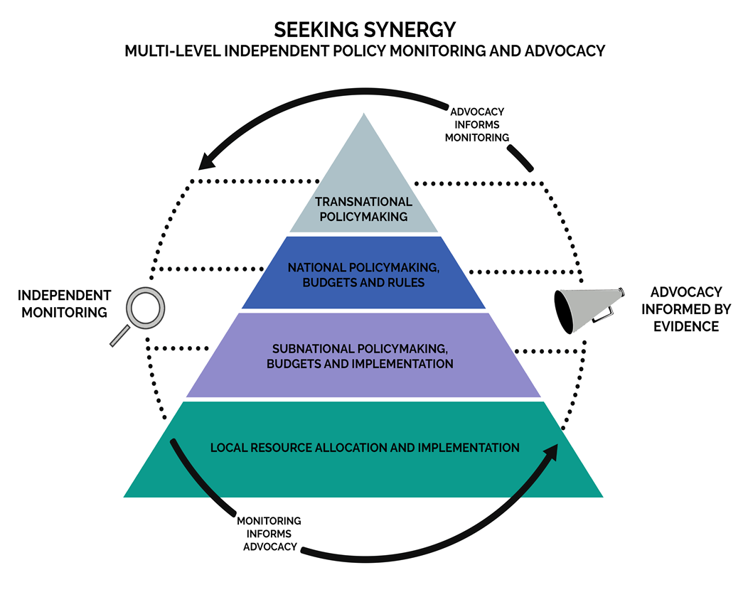
Example of a SAcc strategy:
Vertical integration…
….combines multiple tactics
Monitoring of authorities informs stakeholder advocacy
Advocacy informs monitoring
Multi-level approach – action at each level informs action at other levels
Key to address the “squeezing the balloon” problem

Slide 17
‘Voice’ and ‘teeth’ are shorthand…
‘Voice’ refers here to both the aggregation and representation of underrepresented stakeholders – including capacity for collective action
‘Teeth’ refers here to authorities’ capacity to respond to voice
In other words: What can authorities (or allies) deliver?
Challenge: How to trigger virtuous circles, in which tangible actions enable informed voice & action, which in turn trigger and empower reforms, which can then encourage more voice?

Slide 18
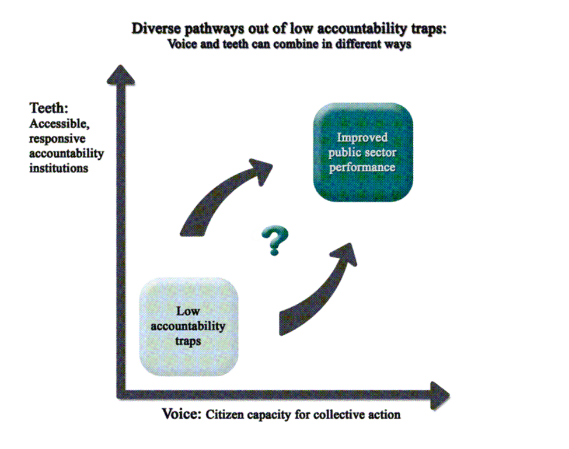
Connecting the dots between participation and accountability: voice plus teeth

Slide 19
Sum up:
What works in the SAcc field?
Voice needs teeth to have bite…
…. but teeth may not bite without voice

