Slide 1
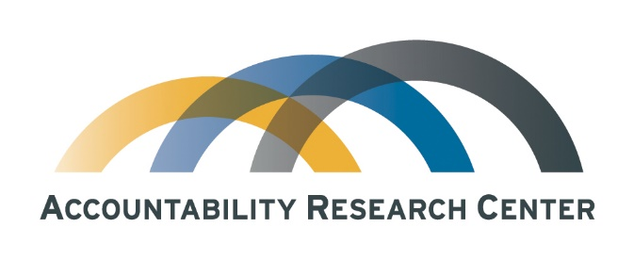
Rebooting research agendas:
Next generation questions for
“Accountability Studies”
Jonathan Fox
Accountability Research Center, American University
Notes:
With this overview, I’m attempting to stick to the big picture, and set us up for the next few days of discussions
In some respect, trying to elevate what is less visible (so far)

Slide 2

Classic theories of change for accountability
Classic causal chain: T > P > A
Underlying ideas go back a century:
“Sunlight is said to be the best of disinfectants; electric light the most efficient policeman.” (Brandeis, 1913)
This common-sense sentence implies two different theories of change – one reactive, the other preventative…

Slide 3
Why reboot research agendas?
Social science still has difficulty explaining accountability
Electoral democracy is not sufficient for accountable governance
Theories about “transitions to accountable governance” today are where “transitions to democracy” were in the early 1980s
Conventional wisdom about evidence-based policy-making has difficult explaining actual policy-making
Mexico is a paradigm case of the disconnect between transparency and accountability

Slide 4
Foundational concepts are still key
Vertical & horizontal accountability (O’Donnell)
Diagonal/transversal accountability – state-society hybrids (Isunza)
Accountability = Answerability + enforcement (Schedler)
Social/societal accountability (vs political) (Peruzzoti & Smulovitz)
State-society interfaces (Long; Gurza & Isunza)
Invited/claimed spaces (Cornwall)
Accountability politics: ‘the arena of conflict over whether and how those in power are held publicly responsible for their decisions’ (Fox)

Slide 5
Limitations in the accountability literature
Classic concepts are strong on description, but explanatory frameworks lag
Practice is ahead of research
Applied research is ahead of conceptual and analytical work
Silos slow synergy (sectoral, disciplinary)
Limited menu of methodologies crowds out big questions

Slide 6
Accountability 2.0: Criteria for framing questions
Intellectually significant
  Draw on classic social science concepts and debates
  Analytically tight – yet empirically open-ended…
Informed by dialogue with action strategists
Relevant to change strategies

Slide 7
Accountability 2.0 questions fall into three thematic areas
Citizen action for accountability
State-society synergy
Rethinking the power of information

Slide 8
Citizen action for accountability:
Elections, constituencies, scale, strategies

Slide 9
Do elections really serve as accountability mechanisms?
What drives political accountability?
Conventional wisdom in political science often assumes that elections are accountability mechanisms
This assumes that voter choices are primarily driven by retrospective motivations
Yet voters are also motivated by prospective choices – which could be in tension with the retrospective assumption
What does the evidence say?

Slide 10
How to broaden social/civic constituencies for accountability?
Broadening has two dimensions, territorial and social.
  How can pro-accountability initiatives grounded in collective action spread horizontally within districts, provinces and countries?
  … while becoming more inclusive of directly affected social and civic actors?

Slide 11
How to take scale into account? Four approaches
Scaling up: Doing more of X, reaching more people, but may be watered down
Diffusion: Innovations travel horizontally across state and society, by promotion or emulation, but may be transformed in the process
Scale shift: Change strategies adapt by shifting levels of action to find new targets
Vertical integration: Monitoring & advocacy builds on scale shift (when it’s multi-level) & diffusion (when it broadens social base with social inclusion)

Slide 12
How are CSOs held accountable?
First, distinguish between membership organizations and NGOs
Downwards accountability within membership orgs?
Why is internal democracy so hard?
Upwards accountability for NGOs (to boards)
Recall classic sociological problem of the “Iron Law of Oligarchy”
How do non-electoral accountability mechanisms work for CSOs?
  Exit, voice and loyalty… (e.g., coops)
  Reputational risk

Slide 13
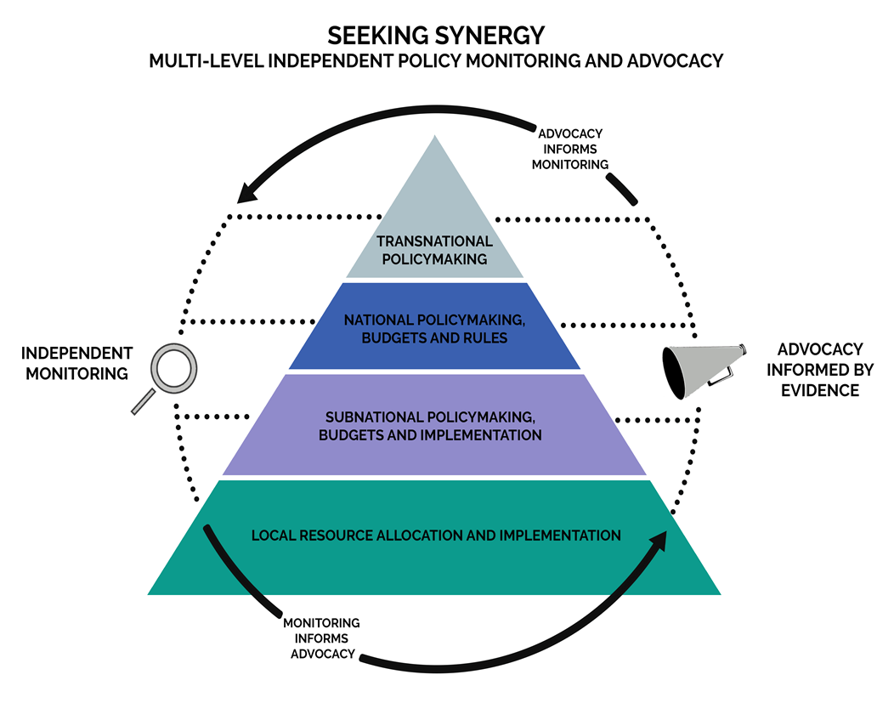
What can vertical integration do?
Can the coordination of independent policy monitoring and advocacy across multiple levels of government bolster accountability impacts?
Source: J. Fox and J. Aceron, “Doing Accountability Differently,” U4 Issue Paper, 2016

Slide 14
How does transitional justice weigh tradeoffs?
  Does addressing past abuses risk making future abuses more likely, by provoking backlash?
  Reactive approaches impose consequences on guilty
  Preventative approaches seek to minimize future abuses
  When are there tradeoffs vs synergy between these two approaches?
  Truth with justice or truth vs justice?

Slide 15
Accountability institutions: Who guards the guardians?
Question posed by the Roman poet Juvenal:
  ?Quis custodiet ipsos custodes? (see also Plato, Heinlein, Star Trek, Batman, Dr. Suess, Homer Simpson)
Institutional autonomy is two-edged sword – necessary yet risky
When accountability institutions are ineffective, is the cause weakness or capture?
When public oversight institutions are strong and autonomous, they can abuse that power (e.g., Colombian Procurador’s removal of elected officials, or Sergio Moro in Brazil).

Slide 16
State-society synergy:
Insider/outsider, voice and teeth

Slide 17
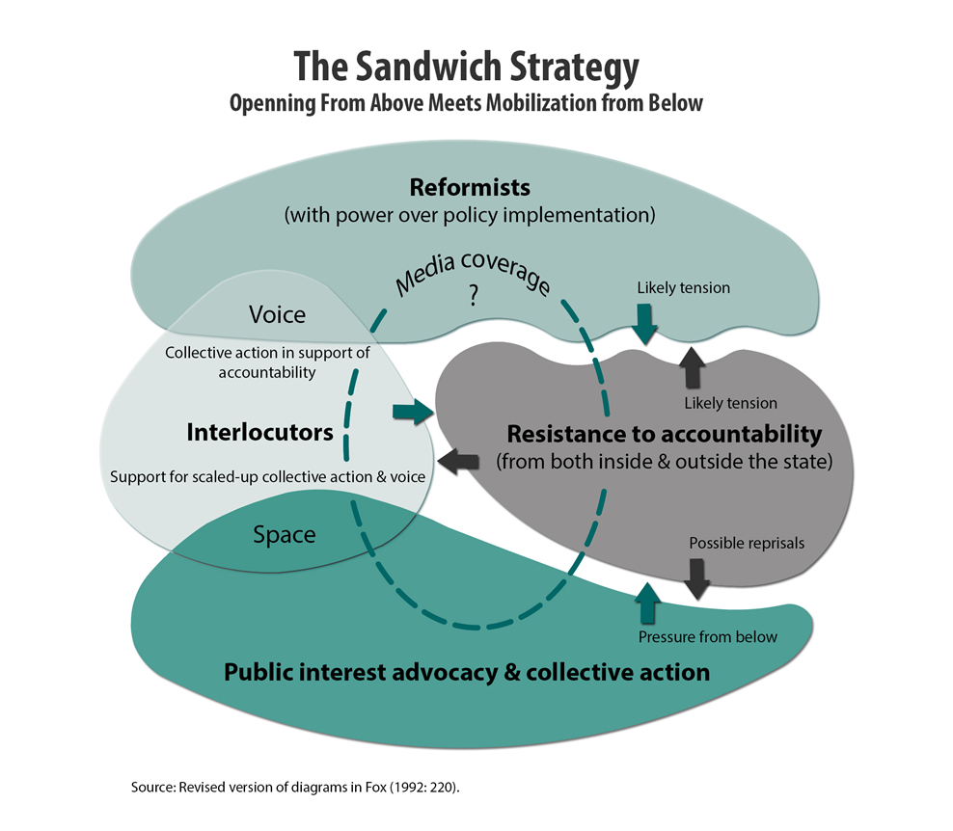
Understanding synergy: Sandwich strategies
Snapshot of change dynamic
Low accountability traps are perpetuated by weak pro-accountability actors in both state and society.
Can coalitions bridging the state-society divide turn vicious circles of disempowerment into virtuous circles of mutual empowerment?

Slide 18

How can voice and teeth reinforce each other?
How does state-society synergy work over time?
What processes can drive increased state responsiveness (teeth) to citizen-led accountability initiatives (voice)?
What makes public institutions that are designed to listen to citizens effective?
  For ex. Ombuds agencies, human rights commissions, grievance redress mechanisms, civilian police review boards
  Yet they may value autonomy over collaboration (e.g., ASF)

Slide 19
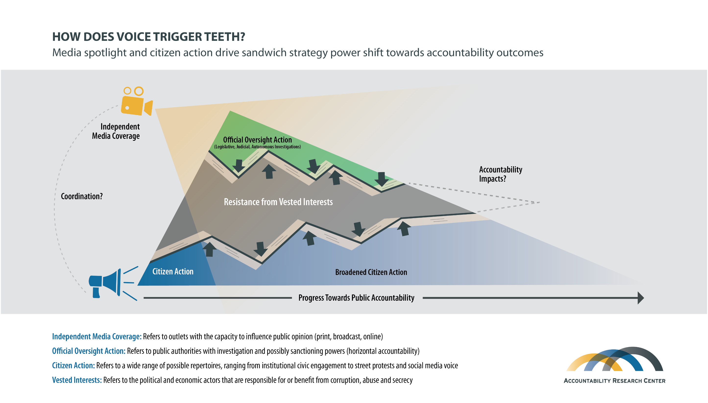

Slide 20
Rethinking the power of information: Targeted transparency, truth-tellers culture & disinformation

Slide 21
Can targeted transparency motivate & inform action?
Targeted information (Fung et al 2007):
  Proactive disclosure
  Info perceived as accessible, relevant and actionable for transparency
  Targeted transparency designed to influence “action cycles”
  Classic case: Toxic Release Inventory
  Yet concept easily watered down (“transparencia focalizada”)
Puzzling lack of uptake of the concept
What kinds of targeted transparency strategies are effective?

Slide 22
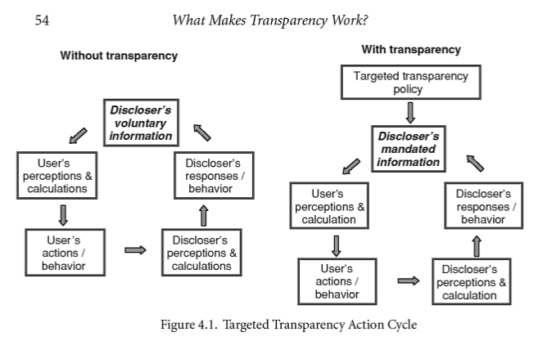
How do transparency action cycles work?
From Full Disclosure: The Perils and Promise of Transparency by Archon Fung, Mary Graham, and David Weil (2007) p.54

Slide 23
How to legitimate and protect truth-tellers?
“Truth-tellers” like “whistleblowers” - are public or private sector insiders who release information about institutional failures
They inform accountability efforts by providing the undeniable evidence needed to identify specific causes and perpetrators of abuse (smoking guns)
They often pay a high personal price for their disclosures
How can their institutional betrayal be reframed as civic duty?
How can truth-tellers be supported more effectively?

Slide 24
How is accountability understood in popular culture?
As a trans-ideological concept, how is the idea understood, communicated, contested and appropriated?
How to disentangle upwards vs downwards accountability?
Who is the first mover? (“corruption as a collective action problem”)
If enforcement actions are selective, how to avoid delegitimizing perception of political bias?
Are norms a cause or a consequence of impunity?
How can accountability strategies engage effectively with mass popular culture, in order to both name and shame and name and fame pro-accountability actors?

Slide 25
How can information compete with disinformation?
Problem: “the big lie” often works…
If “information is power,” does disinformation have more?
How do the drivers of the diffusion of information vs disinformation differ?
Context: How to disentangle norms, beliefs and opinions?
How does the concept of accountability apply to hold private digital platforms that host others’ hate and lies?
How to address the tension between regulation of speech and freedom of expression?

Slide 26
Cross-cutting methodological challenges
Uncertain time horizons
  Accountability impacts are unlikely to follow linear patterns (J-curve?). How can analytical frameworks take discontinuous change dynamics into account?
What evidence counts?
  What kinds of evidence is needed to inform action? (“Precautionary principle”)
  Tension between field experiments and “Sherlock Holmes” approach to evidence
Positive outliers
  Conventional impact evaluation approaches invisibilize variation
  How to identify factors that explain exceptions to dominant patterns?

Slide 27
Thank you!
Jonathan Fox
School of International Service
American University
fox@american.edu
www.jonathan-fox.org
www.accountabilityresearch.org

