Slide 1
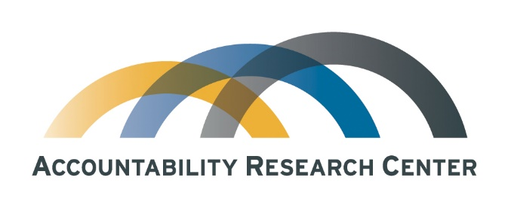
Taking scale into account for
Transparency, participation & accountability strategies
SPARK/IBP Webinar
July 24, 2018
Prof. Jonathan Fox
Accountability Research Center
American University School of International Service
www.accountabilityresearch.org

Slide 2

Why think about scale?
    To get beyond fragmented, one-off projects
    Scale suggests impact (more X, bigger Y)
    How does this relate to the field of transparency, participation & accountability (TPA)?
    It turns out there are multiple ways of thinking about scale
    Just as there are many ways to think about impact…
    Key for TPA: How can “taking scale into account” inform practical strategies for power shifts?
July 24, 2018

Slide 3
Context: Tactical or strategic approaches?
    Tactical approaches focus on tools & address one link in longer causal chains
    Strategic approaches take a more systemic approach
    Context: Donor-funded TPA initiatives have been dominated by tactical approaches
    SPARK proposes “doing TPA differently” by being more strategic
July 24, 2018

Slide 4
Tactical approaches to TPA:
    Fundamentally tool-led, bounded interventions (e.g., citizen report cards, interface meetings, national budget analysis)
    Information alone is expected to inspire collective action or to trigger accountability mechanisms
    Citizen voice expected to have sufficient power to influence public sector performance
    Exclusive focus either on local or national arenas
    Designed to be measurable to satisfy donor “does it work” questions
July 24, 2018

Slide 5
Strategic approaches to TPA:
    Informed by power analysis
    Multiple, coordinated tactics reinforce each other
    Focus on enabling environments for collective action
    Take the accountability ecosystem into account
    Link citizen voice to governmental reforms that bolster public sector responsiveness (voice plus teeth)
    Seek synergy between monitoring and advocacy
    Link advocacy across multiple levels of governance
    These processes are iterative, contested and therefore uneven & therefore measuring impacts requires fresh approaches
July 24, 2018

Slide 6
Taking scale into account: Four approaches
Scaling up
Scale shift
Vertical integration
Diffusion
July 24, 2018

Slide 7
1. Scaling up
    Do more of X, or reach more people with Y
    Yet transitioning from promising pilots to large programs & policies is easier said than done
    Managerial approaches predominate
    Scaling up more appropriate for service delivery than for TPA strategies, which involve power shifts
    Plus, beware: Evidence shows that as “participatory” programs scale up, “invited spaces” often get watered down or captured
July 24, 2018

Slide 8
2. Diffusion: Scaling across?
    “Spread or flow of an innovation across actors in a social system”
    For spread of empowerment processes, social movement analysis focuses on diffusion of collective action
    For spread of pro-accountability institutional change, policy diffusion analysis focuses on how policy innovation is taken up from one government to another (at subnational or national levels)
    For example, consider now large lit on diffusion of participatory budgeting… how does PB change in the process?
July 24, 2018

Slide 9
3. Scale shift
  “Change in number & level of coordinated collective actions, with new range of actors, targets & claims”
  Scale shift - can go upwards or downwards
    Local => national or global (“boomerang strategy”)
    Global or national => local
  Mechanisms: Cross-cultural interlocutors key
  Plus lateral diffusion broadens the social/civic base grounding scale shift
July 24, 2018

Slide 10
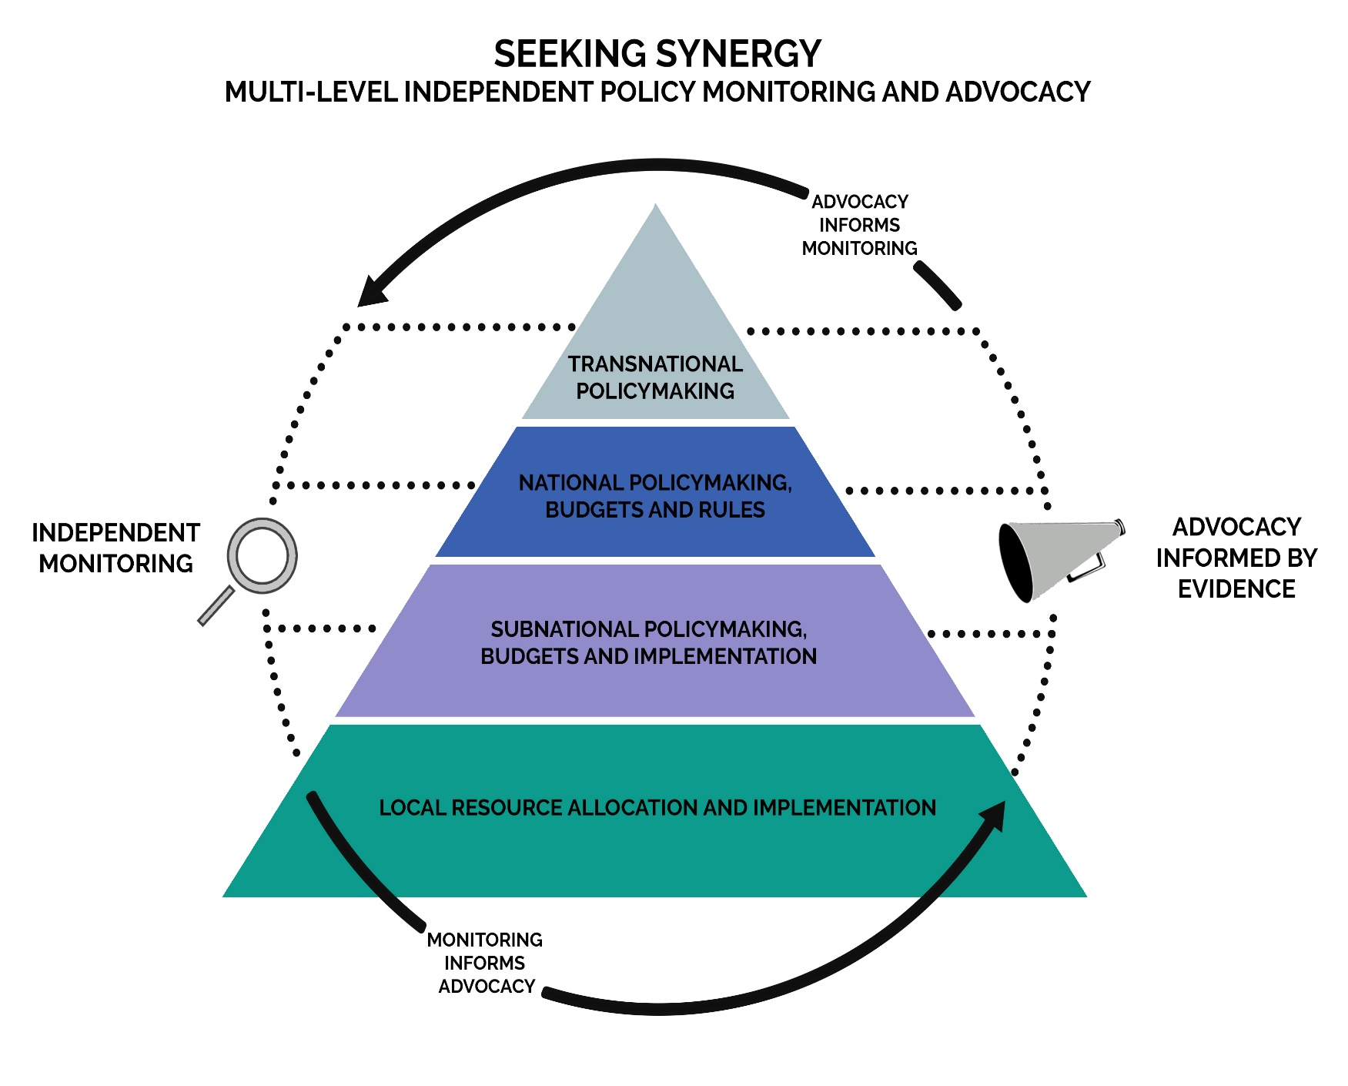
4. Vertical integration
  Scale differs here because it connects the dots:
  Public interest oversight efforts linked across levels
  Independent monitoring & advocacy inform each other
  Even “partial” vertical integration can add leverage (e.g, linking just two levels)
July 24, 2018

Slide 11
Vertical integration & advocacy challenges
  How to address causes, not just symptoms of accountability failures?
  How can strategies address the often vertically integrated nature of anti-accountability power structures?
  How to address “squeezing the balloon” & identify where public sector decisions are really made? (follow the money)
  How can broadening the civic base w social inclusion bolster multi-level advocacy? (diffusion plus scale shift)
  For multi-actor advocacy initiatives to gain leverage, how can the whole become greater than the sum of the parts?
July 24, 2018

Slide 12
Cases of vertical integration
  Philippines – Textbook Count (monitored full “supply chain”)
  Ghana – CSO Platform on IMF Bailout
  Nigeria – Anambra state (links community to state govt advocacy)
  India – SATHI (grassroots clinic monitoring & state advocacy)
  Guatemala – CEGSS – (municipal-district health system monitoring)
  Mexico – Community Food Councils
  What other cases come to mind?
July 24, 2018

Slide 13
Recap: Taking scale into account from four directions
  Scaling up: Bigger can be better – or can get watered down
  Diffusion: Innovations can travel across both state and society – though may get transformed in the process
  Scale shift: Change strategies adapt by shifting levels of action to find new targets
  Vertical integration: Monitoring & advocacy builds on scale shift when it’s multi-level, & builds on diffusion when it broadens social base with social inclusion
July 24, 2018

Slide 14
Threading the E&A needle
Scaling up
(bigger, more)
Scale shift
(vertical)
Vertical integration
(multi-level)
Diffusion
(horizontal)
July 24, 2018

Slide 15
To sum up: How to bring together power & scale?
  Scaling up: Implicitly promoted from above, more focused on activities than power
  Diffusion: Can broaden the social/civic base & be promoted either from above, below or laterally
  Scale shift: Contests power by targeting bottlenecks
  Vertical integration: Connects the dots to inform & target causes, not just symptoms of accountability failures
July 24, 2018

Slide 16

Comments welcome - thanks
Jonathan Fox
School of International Service
American University
fox@american.edu
www.jonathan-fox.org
www.accountabilityresearch.org

