Slide 1
Accountability Keywords
Jonathan Fox
Accountability Research Center
School of International Service
American University
Nov. 18, 2016

Slide 2
Preview: Framing issues by clarifying terms:
Accountability to whom? Upwards or downwards?
Different kinds of accountability: Social, political , legal, or informal
Two different dimensions of accountability: “Answerability” and/or enforcement
Different accountability goals: Preventative or reactive approaches?
Unpacking SAcc initiatives: Tactical vs. strategic
Strategies for power shifts: Sandwich strategy, monitoring plus advocacy, vertical integration

Slide 3
1) Accountability to whom?
Upwards > from public sector workers to managers to policymakers
Downwards > from public sector agencies to citizens
Horizontal > checks and balances, oversight agencies

Slide 4
2) Different kinds of accountability:
Social accountability: Umbrella term of citizen voice and action
Political accountability: From governing leaders to citizens (or to checks & balances institutions)
Legal accountability: Prosecution and judicial action
Informal accountability: Culture shifts, stigmatizing abuse

Slide 5
3) Two different dimensions of accountability:
“Answerability” (govt actors explain their actions to citizens and/or to checks & balances institutions)
Enforcement (sanctions for specific acts)
The first relies on voice, the second has teeth

Slide 6
4) Preventative or reactive approaches?
Dilemma: do we address causes or consequences of accountability failures?
What are the tradeoffs?
Where to invest limited political capital?
How to build synergy between the two approaches?

Slide 7
5) Unpacking change initiatives:
Tactics vs. strategies
What’s the difference?
The terms are often confused – but why does it matter?
Strategies define goals and the plan to reach them
Tactics are the specific actions for carrying out such plans
Therefore: strategies should drive tactics (many forget this)

Slide 8
Tactical SAcc approaches:
Tool-led interventions (often external)
Limited to citizen voice efforts
Information provision (assumed to inspire collective action that can influence public sector performance)
Are limited to “local” arenas

Slide 9
Strategic SAcc approaches:
Multiple, coordinated tactics (can the whole be > sum of parts?)
Enabling environments for collective action, to reduce perceived risk
Citizen voice coordinated with governmental reforms that bolster public sector responsiveness (voice plus teeth)
Multi-level (linking local-subnational-national actors & targets)
Campaigns or interventions? (campaigns are iterative, contested and therefore uneven processes)

Slide 10
Tactical:
>Tool-led
> Emphasis on info provision
> Voice only
> Locally bounded
> Interventions (external)
For details, see J. Fox, “Social Accountability: What Does the Evidence Really Say?” World Development, 52, August 2015 (open source)
Strategic:
> Multiple tools
> Emphasis on enabling collective action
> Voice plus teeth (state response)
> Multiple levels of engagement
> Campaign logic

Slide 11
8) Three strategies for power shifts:
Sandwich strategies
Vertical integration
Harnessing media & citizen action to bolster pro-accountability agencies

Slide 12
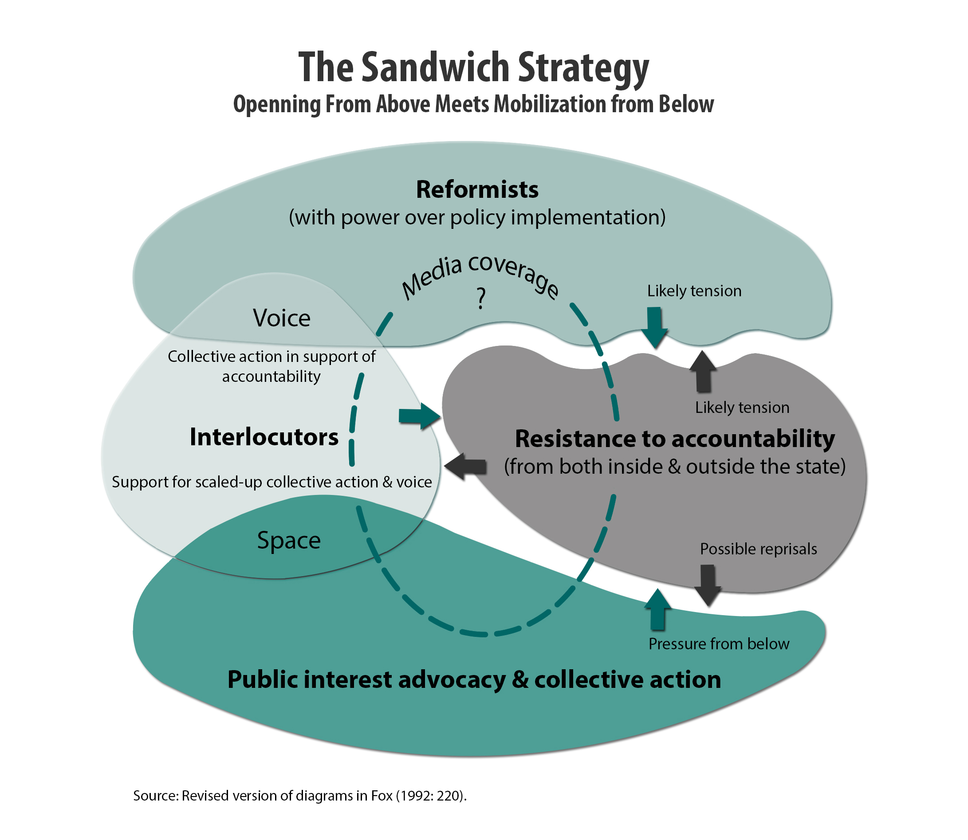
“…you push from below, and we will squeeze from above…”
Reformist director of Mexican rural food supply agency (1986, before electoral democracy), address a national assembly of autonomous Community Food Councils
Place your screenshot here

Slide 13
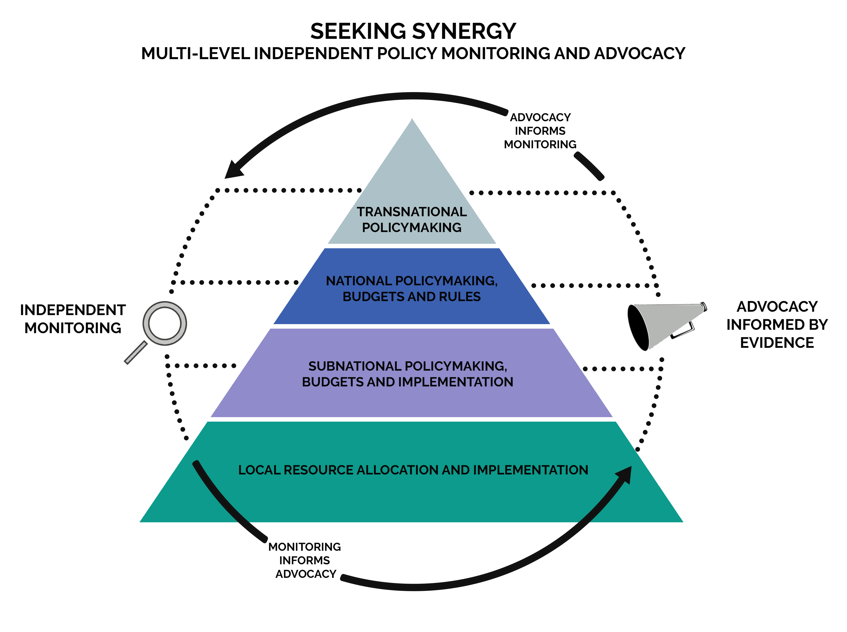
Unpacking vertical integration:
Working across scale while bridging monitoring and advocacy…
See J. Fox and J. Aceron, “Doing Accountability Differently,” U4 Issue Paper, Aug. 2016
Place your screenshot here

Slide 14
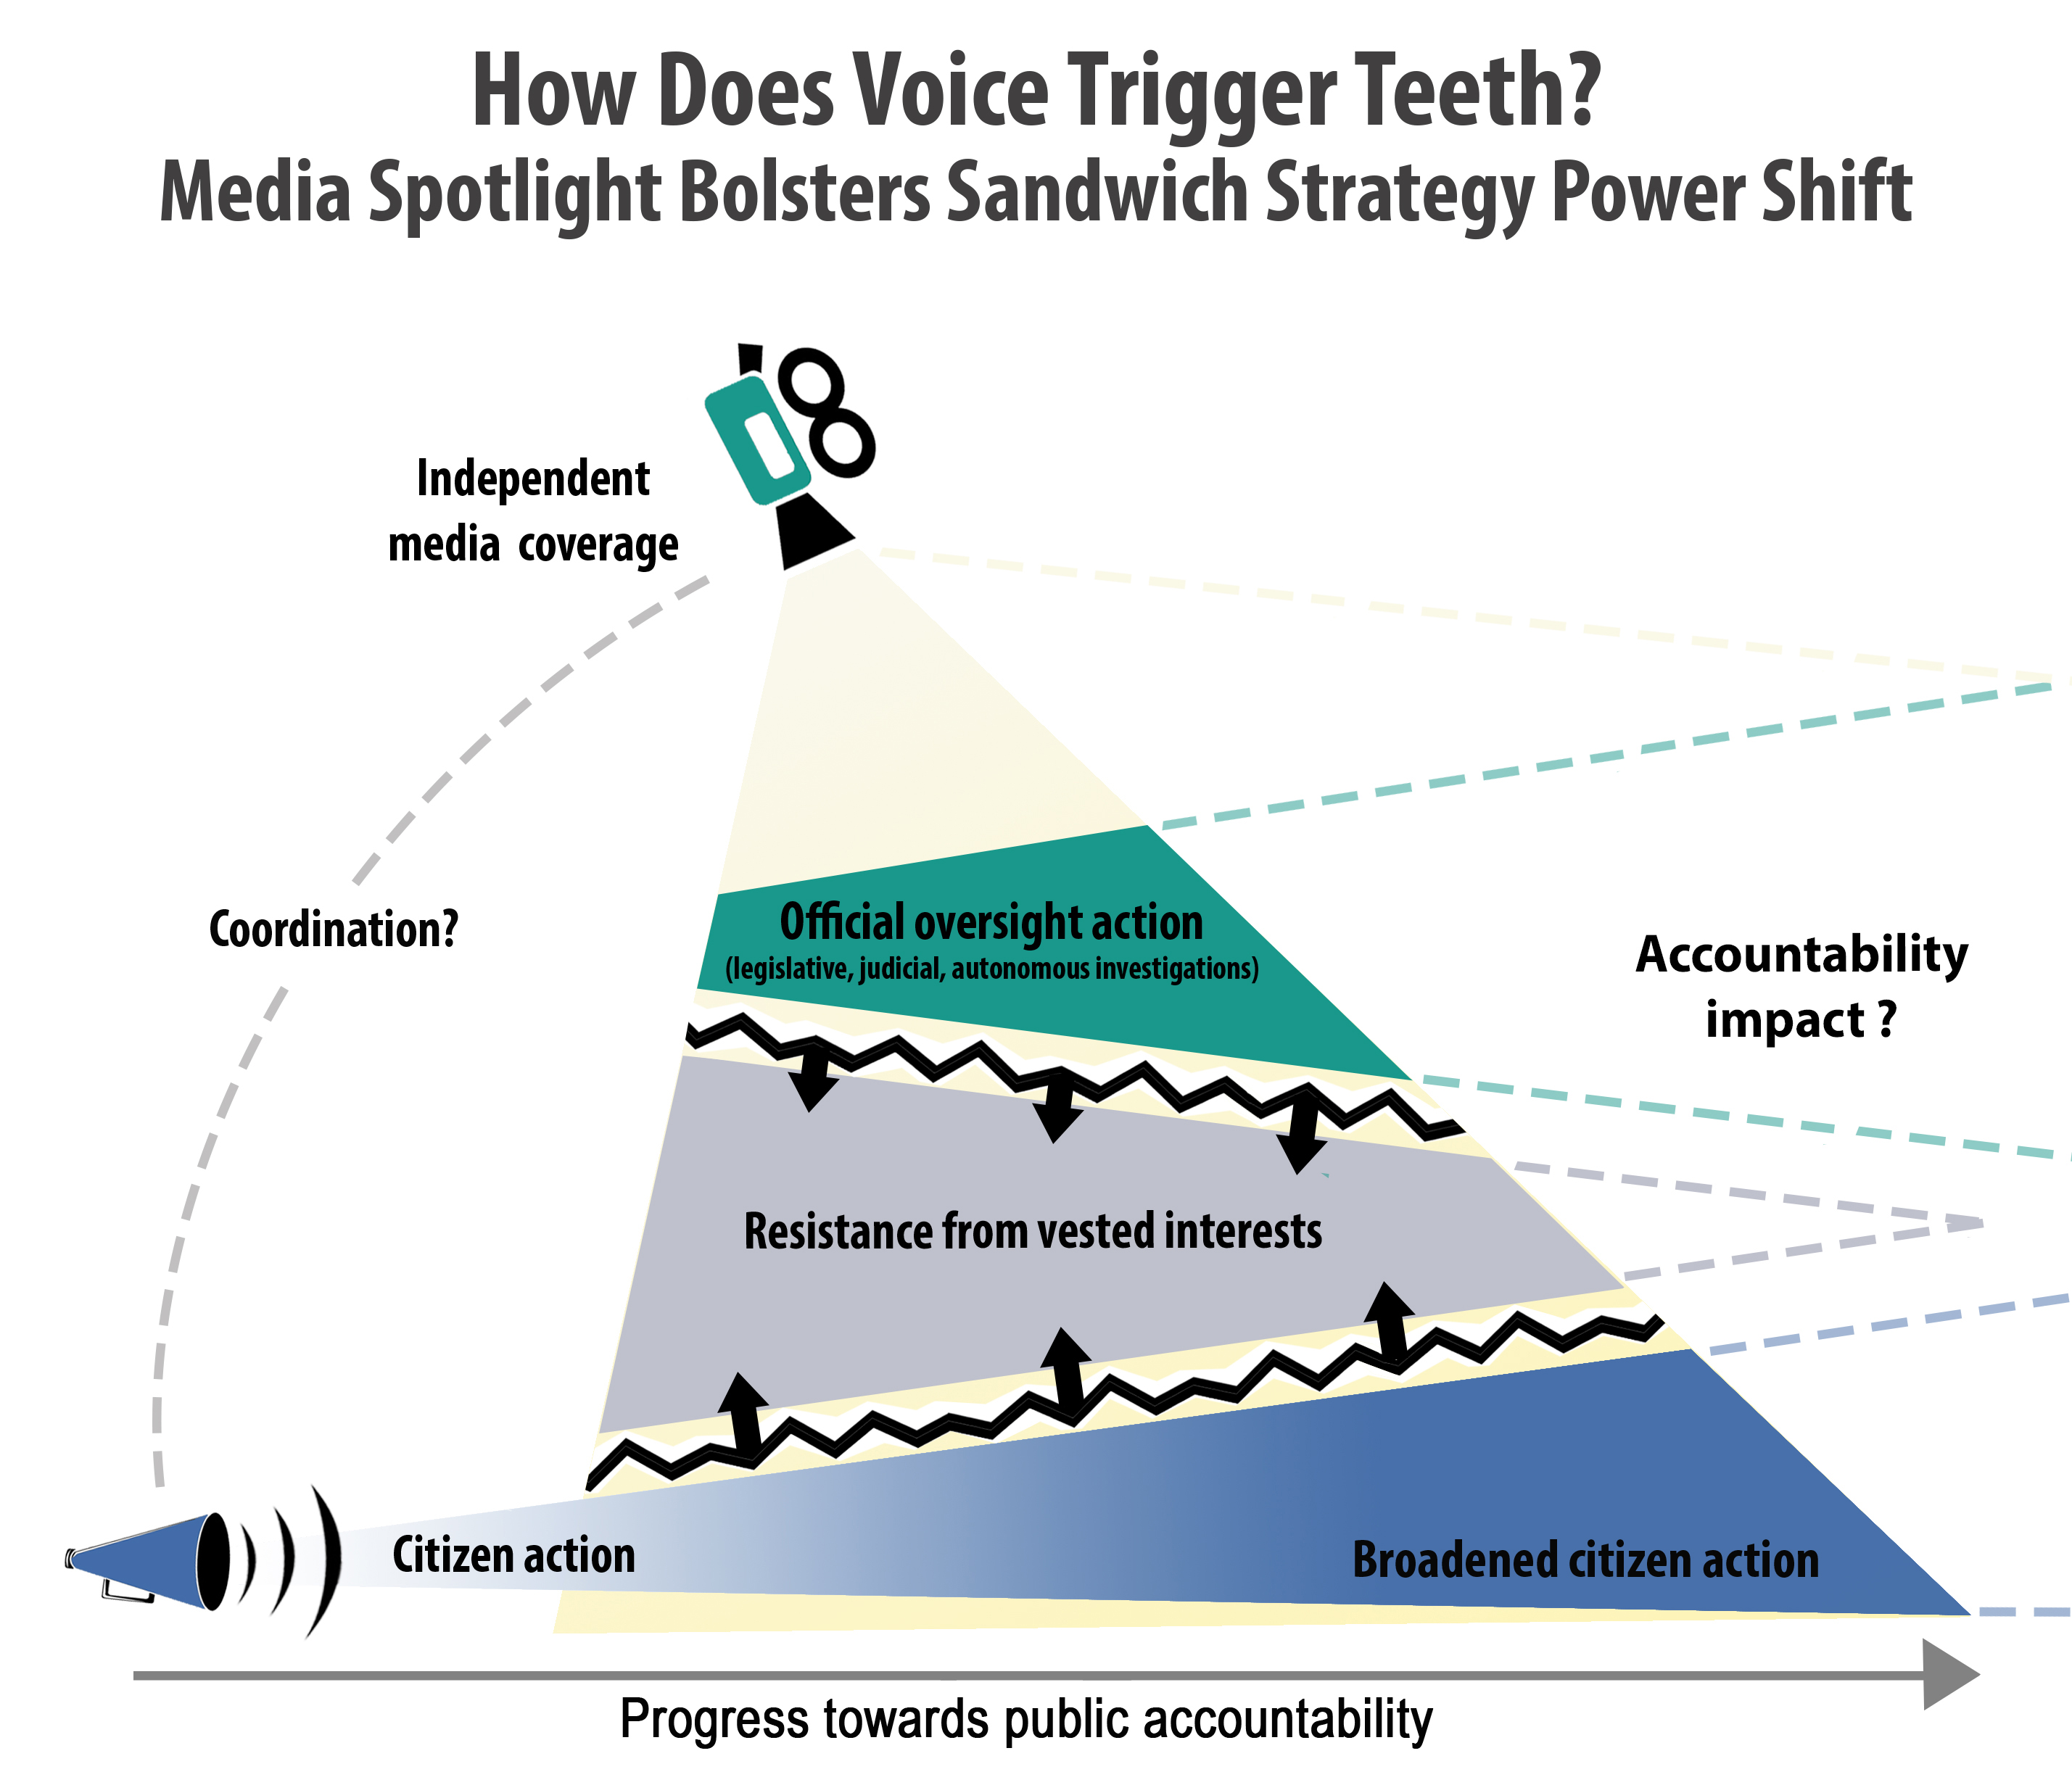
Place your screenshot here
Dilemma:
How to trigger virtuous circles to empower pro-accountability actors?
State-society synergy between:
Citizen action, media coverage and the activation of public oversight agencies

Slide 15
To conclude > questions for discussion:
> How can accountability practice inform future research?
> What accountability research questions can inform future practice?
> How can COPASAH’s work help to address these challenges?

Slide 16
Thanks
To continue the conversation:
fox@american.edu
www.jonathan-fox.org

