Slide 1
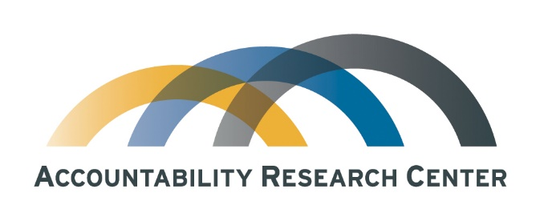
Learning for what?
Incubating action-research partnerships for accountability initiatives
Jonathan Fox
Accountability Research Center
School of International Service
American University
July 5, 2017

Slide 2

Where is this coming from?
Experience with embedded action-research, advisory and/or board service:
  Mexican peasant/indigenous orgs and rural dev CSOs (1982-2013)
  International development advocacy (BIC, 1994-2008; Oxfam, 2006-15)
  Latino immigrant organizations & allies (1997-2013)
  Open government advocates (OGP 2013-15; Fundar, 2006 - )
  Donor collaboratives (GPSA, 2013-15; TAI, 2015-16)
  Like-minded action-researchers (IDS, 2016 - )
July 5, 2017

Slide 3
Learning investments include both process and product – but to what end?
Category can include: evaluation, research, dissemination, training & org learning
For more learning? (knowledge for its own sake)
For grantee strategies (what to do and how?)
For donor strategies (what to fund next?)
For compliance (did grantees do what they said they would?)
To inform & influence broader communities of practice
To influence opinion-makers/policy-makers
To serve academic careers/scholarly prestige
Cross-cutting issue: are the questions being asked big or small-bore (tactics or strategy?)
Reframe the question: Learning for whom?
July 5, 2017

Slide 4
Transparency, participation & accountability needs learning because we are hitting the wall…
Challenges specific to the TPA field include (even where civic space not closing):
  In practice, sunshine often fails to disinfect (can’t shame the shameless)
  Tool-led approaches lack strategic focus on underlying causes
  Tech-enabled feedback loops often don’t close (voice is ignored)
  Change strategies may not take vested interests into account
  Backsliding abounds (e.g., 5 of 8 founding OGP gov’ts)
  TPA work often not embedded in broad movements with civic muscle
July 5, 2017

Slide 5
Reasons for limited traction vary, underscoring need for learning
Too soon to tell? Short timeframes can miss future impacts (“J curve”)
“Light touch” interventions lack leverage, so why expect impact?
If a problem is really hard, why would a solution “work” most of the time?
Looking in the wrong place: instead focus on “positive deviation” and then analyze diffusion & scaling processes
Mixed results points to the urgency of the “what works” question
…But that question has invisible baggage
July 5, 2017

Slide 6
Unpacking the “what works” question
The relevance of the question seems self-evident…
… Until you ask “who decides?”
Where you stand depends on where you sit
Donors, academics, think tanks, action strategist goals overlap only partially
What works could be understood as asking how to do X better, vs considering whether to drop X in favor of Y?
Different goals and interests lead to preferences for different kinds of learning and research (e.g., embedded learning vs external evals)
This means big tradeoffs – RCTs, investigative reporting, follow the money or crowdsourcing via civic tech?
July 5, 2017

Slide 7
ARC’s approach
Focus for partnerships: a subset of practitioners called “action strategists,” allied with civic/social movements
Problem statement: Available TPA research & evals are rarely taken up by action strategists – mainly because they don’t ask the right questions
Proposed alternative: Open a seat at the table for TPA action-strategists to inform research agendas, starting with balanced, trust-based partnerships
Two pathways can link research & learning to more effective practice
  Embed research in organizational learning (easy to say, but in practice?)
  Practitioner-led agendas that informs research that contributes to broader TPA thinking about how to find more strategic focus on sustainable power shifts
July 5, 2017

Slide 8
What does this mean in practice?
ARC partners with public interest groups and policy reformers in the TPA field (broadly defined), in order to:
Support partner learning agendas (“critical friend” role, focused learning exchanges)
Invest in exploratory research partnerships to inform future research questions that address their strategic TPA challenges
Collaborate to communicate Southern front-line perspectives to global agenda-setters, via curated, crisp writing and images
July 5, 2017

Slide 9
Incubation by threading the needle: Seven steps
How does ARC approach exploratory research?
1) Partner with strategic learning orgs with civic base/allies
2) Pursue questions that directly support TPA partner change strategies
3) Invest in exploratory field research to inform more ambitious proposals
4) Be methodologically credible to relevant audiences
5) Embed the research to advance partner’s organizational learning
6) Be potentially fundable – and
7) Frame questions that resonate with global discussions in the TPA field.
July 5, 2017

Slide 10
ARC partnership stories
Society for Social Audit, Accountability and Transparency (state gov’t of Telangana, India)
  Grassroots movement-inspired policy reformers embed TPA into big anti-poverty programs, impact dilemmas, exploratory research informs open government strategy
Government Watch (Philippines)
  Political defeat of top-down technocratic reformers causes need to reboot TPA strategy, drawing on three years of mutual learning & joint pubs, analysis now looking backwards and forwards grounded in new civic network
Center for the Study of Equity and Governance in Health Systems (Guatemala)
  Researcher allies of community health defenders rethink what kinds of evidence really bolsters advocacy leverage, framing lessons for global TPA field
July 5, 2017

Slide 11
Wrapup: Incubating an incubator
ARC is just emerging from “soft launch”
2013-2015 - consultation & planning process
2016 - “zero year”
2017 – consolidate partnerships, 1st round of pubs, website launch, seek additional core and project-specific funding
2018 – institutional consolidation (bolster research team, advisory board)
?
July 5, 2017

Slide 12
For further discussion & resources:
fox@american.edu
www.jonathan-fox.org
www.accountabilityresearch.org (under construction)
Thanks

